Slide 1
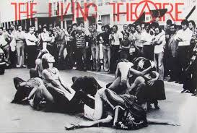

Slide 2
IN memory of Judith Malina
While off the isle of Cyprus in a boat, I saw the head of Aphrodite afloat, And told her I'm an Anarchist and do not vote. She answered, "That's all right". "Oh stay!" I cried. "There are so many things we should discuss: the power of unnecessary kings, The sexual oppression of which Sappho sings..." But she sank out of sight.
J.Malina, Love and politics

Slide 3
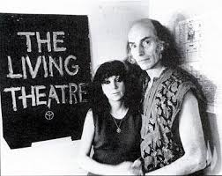
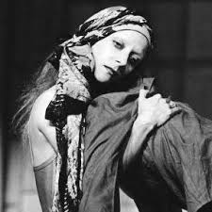

Slide 4
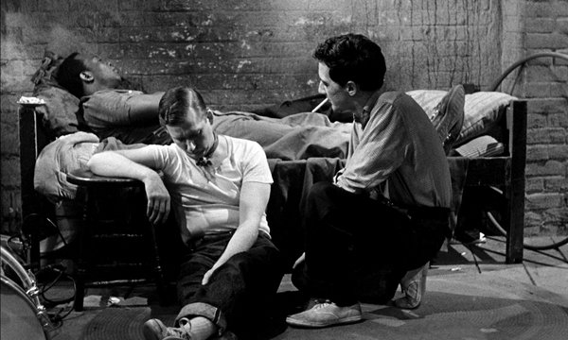
The connection

Slide 5
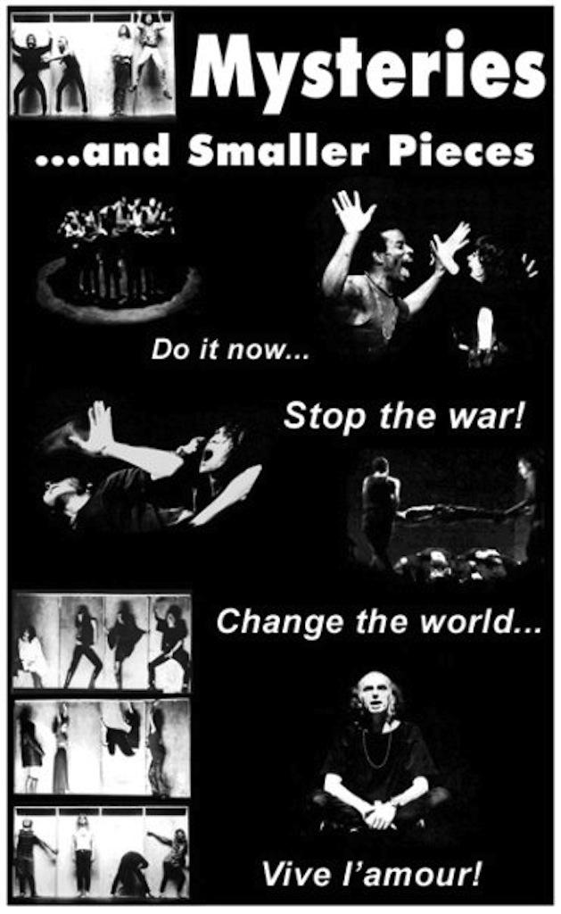
ANTHOLOGY in VIDEO

Slide 6
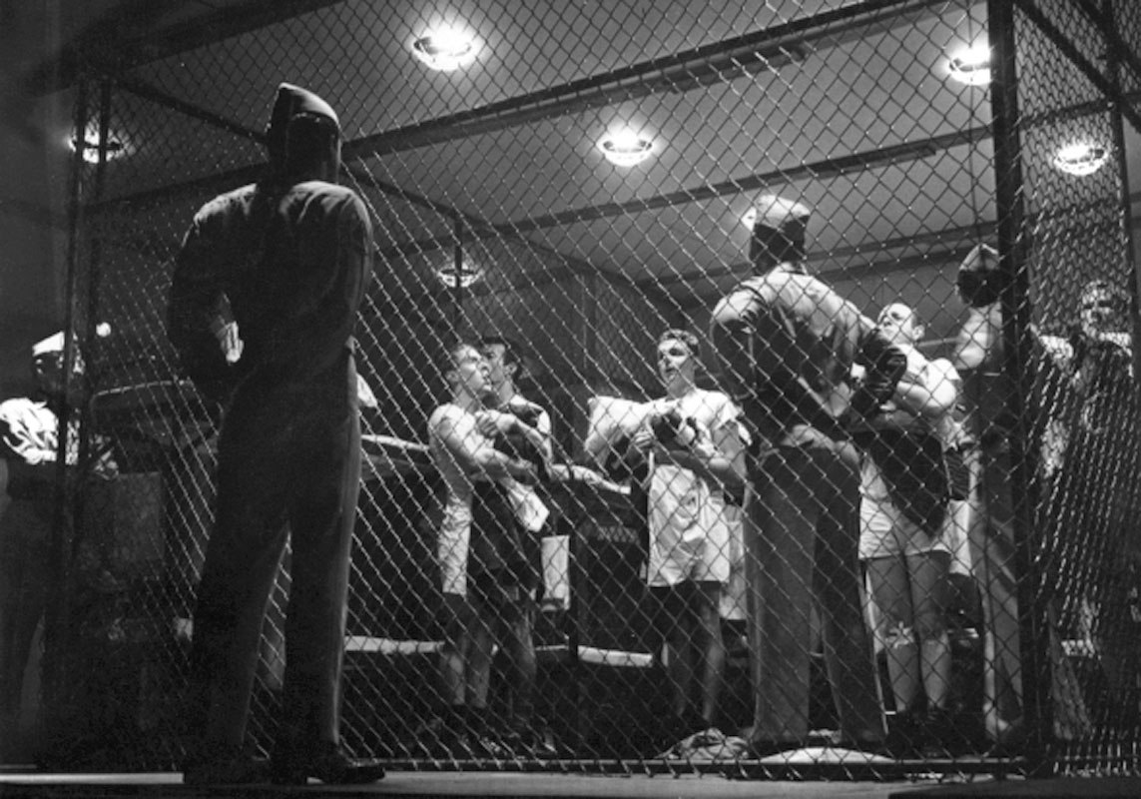
THE BRIG
https://www.youtube.com/watch?time_continue=36&v=qYVvf50CUig

Slide 7
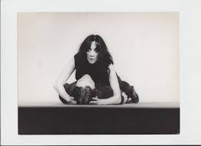
If there is a piece, in which civil disobedience is celebrated, this is precisely Antigone “
I believe that Antigone is within all of us when we refuse to do things in which we don’t believe, when we say no, even when the law threatens to punish us.
We are all Antigone: someone makes only small steps, other bigger towards the most radical change
VIDEO

Slide 8
Antigone is one of the key images and a major source of inspiration of the culture of this planet.
She is a woman and she is a precursor of the liberation movement and represents the will to demonstrate our own strength and the independence of thought and the ability to oppose our decision against the government, the court: even against the people if necessary. JUDITH MALINA

Slide 9
From The Antigone Modellbuch; sketch for Prologue by Caspar Neher
Bertolt Brecht’s adaptation of of Sophocles’Antigone, which he directed at the theatre in Switzerland with his wife Helene Weigel in the title role, was his first production in the German-speaking world after 15 years in exile.
The production was documented in a Model-Book with photographs by Ruth Berlau and with detailed explanations by Brecht himself,.

Slide 10
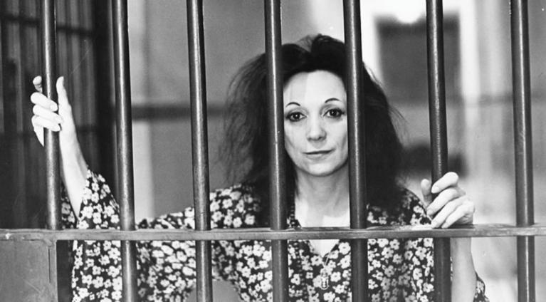
ANTIGONE=MALINA
I worked on the translation of the Modellbuch in Passiac County Jail
The greek character is a precursor of all battles for the affirmation of the self aganinst all power and control systems
I

Slide 11
"Now you have me, can you do more than kill me?"

Slide 12
THEATRE OF THE CRUELTY
I employ the word "cruelty" in the sense of an appetite for life, a cosmic rigor, an implacable necessity; it is the consequence of an act.
Everything that acts is a cruelty. It is upon this idea of extreme action, pushed beyond all limits, that theatre must be rebuilt.
“Theater of Cruelty means a theater difficult and cruel for myself first of all. And, on the level of performance, it is not the cruelty we can exercise upon each other by hacking at each other’s bodies, carving up our personal anatomies, or, like Assyrian emperors, sending parcels of human ears, noses, or neatly detached nostrils through the mail, but the much more terrible and necessary cruelty which things can exercise against us. We are not free. And the sky can still fall on our heads. And the theater has been created to teach us that first of all.”
Antonin Artaud, The Theater and Its Double

Slide 13
KREON Do you admit or you deny that you did it?
ANTIGONE I say that I did and I don't deny it KREON Now tell me, and be brief: are you aware of what was announced in the open city about this particular corpse? ANTIGONE I knew it. How could I help you. It was clear enough. KREON And yet you dared to break my law? ANTIGONE Just because it was your law, a human law, that's why a human being may break it – and I am just as human as you and only slightly more mortal.
(…)
if seem crazy to you because I fear the judgment of heaven, which hates the bare sight of mangled bodies, and I don't fear your judgement,

Slide 14
From <sofocle to Brecht
The significant shift in meaning: from the religious to the political.
The war between Argos and Thebes are removed from myth and takes the form of war of aggression against Argo for possession of iron mines.
The men are responsible for their own destiny, not the gods.
We have to provide a civic model and alternative ethics, a community that is fighting for their ideals.
Antigone is the heroine of a society guided by the spirit of freedom and non-violence and is ready to sacrifice herself for this. But also Polynices who did not take the part of the war of attack.

Slide 15
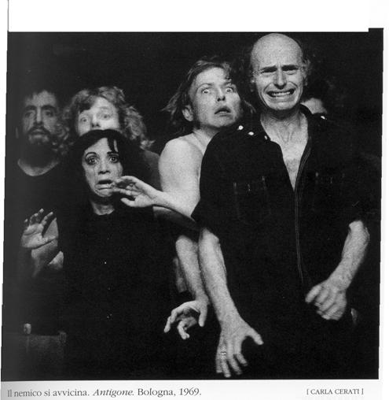
The actors FEARS FOR THE PUBLIC

Slide 16
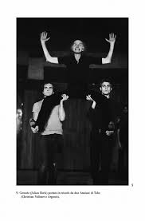
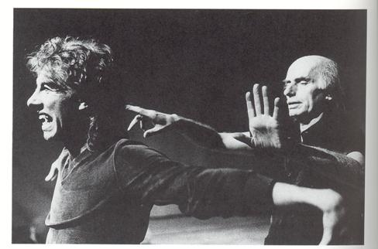
KREON WINDS UP THE SOLDIERS

Slide 17
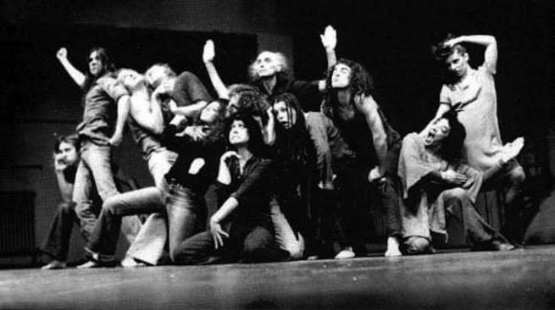
The king, the soldiers, the people

Slide 18
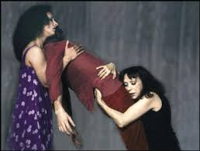
Verfremdungseffekt
One of the most important techniques Brecht developed to perform epic theatre is the Verfremdungseffekt, or the "estrangement effect. The narration in third person for giving objectivity
The Living use languages different to that of the dialogues for enhancing this effect during the descriptions.

Slide 19
Antigone= a bird
It was then that we saw her, standing there crying out. In a sharp voice like a bird that mourn when it sees the empty neest, withou young ones. 3 times she sprinkled dust on the dead man.

Slide 20
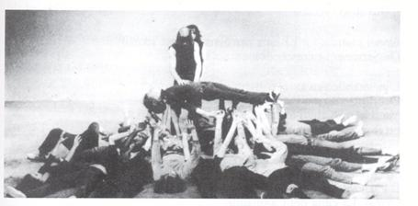

Slide 21
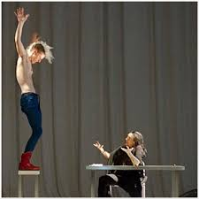
From Living to MOTUS

Slide 22
ANTIGONES
How hard it is to transform indignation into action …”
In 2010 we went to Greece to retrace direct testimony of the killing, by a policeman, of fifteen year old Alexandros-Andreas Grigoropoulos (Alexis) which happened during our first study workshop for Antigone: a “Polynices” with a Sex Pistols T-shirt… This event led us to shift the Antigone-project in an increasingly declared manner towards the theme of contemporary revolt
“I’ve chosen the name of Antigone to reconstruct-trace-delineate-delimit-set forth the theme of revolt in the contemporary,
Let the sunshine in

Slide 23
“I’ve chosen the name of Antigone to reconstruct-trace-delineate-delimit-set forth the theme of revolt in the contemporary,

Slide 24
ALEXIS-ANTIGONE
In August 2010 we went to Greece to retrace direct testimony of the killing, by a policeman, of fifteen year old Alexandros-Andreas Grigoropoulos (Alexis) which happened during our first study workshop for Antigone: a “Polynices” with a Sex Pistols T-shirt… This event led us to shift the Antigone-project in an increasingly declared manner towards the theme of contemporary revolt.

